Slide 1

Vehicle Classification using GPS Data
By Swadesh Vaibhav 2017A7PS0030P
Vipin Baswan 2017A7PS0429P
Saumil Agarwal 2018A7PS0268P

Slide 2
Thanks to-
Kamlesh Tiwari Sir
Priya Ma’am
MapMyIndia Personnel

Slide 3
The Objective of the Project
To classify vehicles into different classes based on their GPS footprints in time, at specific intervals.

Slide 4
Methodology Used
Shallow Models like Decision Tree.
Ensemble Models like Baggage Classifier.
A Deep Learning Model, ANN.
Machine Learning and Deep Learning Techniques

Slide 5
Dataset
The dataset was provided by MapMyIndia. It consisted of the GPS histories of vehicles in 3168 files.
Each file had the following information about various vehicles:
Vehicle ID
Latitude and Longitude
Time Stamps (Date and time format)
Speed of vehicle
Engine status and
Vehicle label.

Slide 6
Preprocessing

Slide 7
Dividing the dataset into trainable format
All the files were processed and divided into files corresponding to each vehicle.
The vehicles were found to be distributed in the following classes-
1. Car : 2549 (78%) 2. Ambulance : 588 (18%)
3. Motor Cycle : 18 (0.5%) 4. Bus : 16 (0.49%)
5. JCB : 1 (0.03%) 6. Truck : 58 (1.7%)
7. Tractor : 15 (0.46%) 8. Mini Bus : 1 (0.03%)
9. School Bus : 1 (0.03%)
10. Not Available : 34 (1.04%, Removed from the training dataset)

Slide 8
Extraction of features -
The Haversine Formula

Slide 9
Extraction of Features
1. The geo-locations of vehicles at various timestamps were used to calculate the distance travelled by each of them using the Haversine Formula.
2. Thereafter, we collected 6 features from the dataset:
1. Average of the speed of the vehicle
2. Average of the change in the position of the vehicle.
3. Variance of the speed of the vehicle
4. Variance of the change in the position of the vehicle.
5. Average acceleration of the vehicle
6. Variance of acceleration of the vehicle

Slide 10
PCA - Principal Component Analysis
To know about the contribution of each factor in the variance of the dataset, we did Principal Component Analysis (PCA). The results are as following:
1. 0.611 explained variance ratio using only 1st feature
2. 0.907 explained variance ratio using first two features
3. 0.960 explained variance ratio using first three features
4. 0.9998 explained variance ratio using first four features
5. 0.9999 explained variance ratio using first five features
6. 1.0 explained variance ratio using all features.

Slide 11
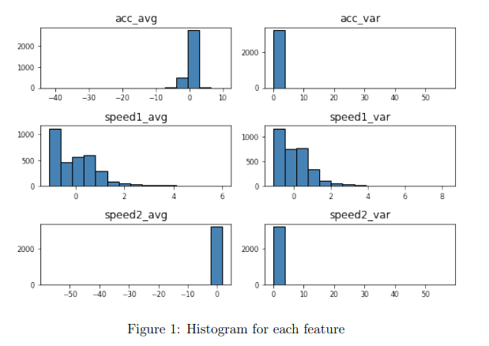
PCA

Slide 12
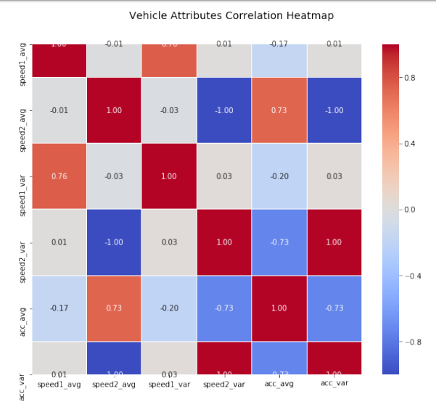

Slide 13
Training Classical ML Models

Slide 14
Training Paradigms used-
For training, we used classical Machine Learning models. We got best performance (in terms of accuracy) from Random Forest Classifier and eXtreme Gradient Boost (XGB) Classifier, with accuracy of 92.44% and 92.31% respectively.
The training and testing process used was 5-Fold Cross Validation.

Slide 15
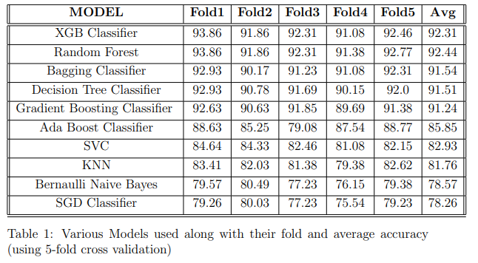
Results of using various models on the dataset-

Slide 16
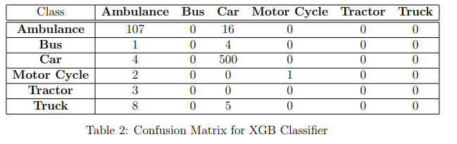
Visualising accuracy using Confusion Matrix

Slide 17
Training the Deep Learning Model

Slide 18
Training Paradigm-
We trained our model using Dense Neural Networks given by the Keras framework.
It gave a test accuracy of 89.2%.
The model architecture consisted of 6 fully connected Neural layers, with 8, 12, 16, 20, 15 and 10 neural nodes respectively.
All the layers were activated using the ’relu’ function.
The final output was obtained using the softmax function.

Slide 19
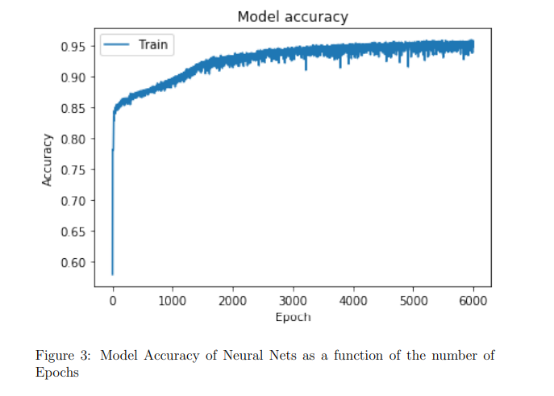

Slide 20
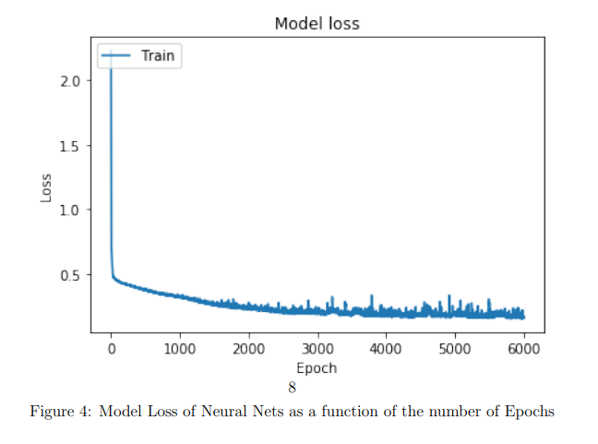

Slide 21
Conclusions

Slide 22
The following conclusions can be drawn from the results of the project-
GPS Data can be used to predict the type of vehicles with an accuracy greater than 90%.
Features that are crucial for this prediction are: speed, mean speed, acceleration, variance in acceleration, mean acceleration.
ML ensemble models are very useful towards this classification.
According to our inferences, eXtreme Gradient Boost classifier and Random Forest Classifier will give the best accuracy

Slide 23
THANK YOU!
Questions?
Doubts?
Queries?
Follow-up on our work?

